Slide 1
Amazon Alexa Review Classification
Capstone Project 2
Catherine Somers

Slide 2
The Problem
Customers are going to usually find things they will like and not like about an Amazon Alexa product
Potential Issue: A product that is missing additional features or creates ease of use problems
Aim for this project: To be able to predict negative feedback
Audience: Product Management and Sales side
How this can help
Improving future product versions
Positively drive product sales

Slide 3
Data and Method Used
Obtain Amazon Alexa Review dataset from Kaggle
Took Amazon Alexa Review data for analysis
Raw data: Total of 3151 values for feedback
For each review there are 5 columns: rating, date, variation, verified_reviews, and feedback
Rating, verified_reviews, and feedback relevant for analysis
Rating has product rating on scale of 1-5, verified_reviews is composed of review text, and feedback denotes whether feedback is positive or negative

Slide 4
Data Wrangling
Imported the .tsv file and formatted it into a Pandas dataframe.
Cleaning:
Retain relevant columns and rows
Extract year, month, day of the week, and review length into separate columns
Estimating review length is an important feature for text classification in Natural Language Processing (NLP)

Slide 5
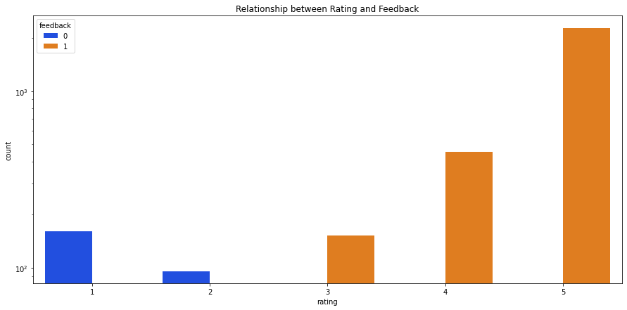
Exploratory Data Analysis (EDA)
Plotting Rating and Feedback on a bar graph shows that in order for feedback to be considered positive, its rating has to be 3 or greater

Slide 6
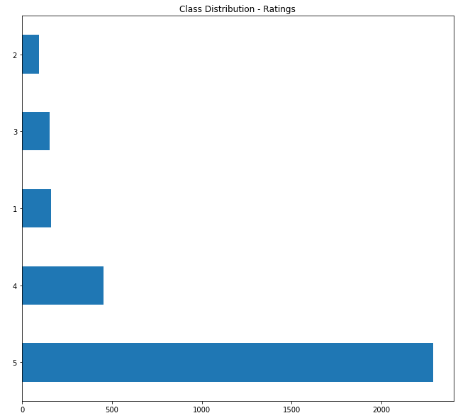
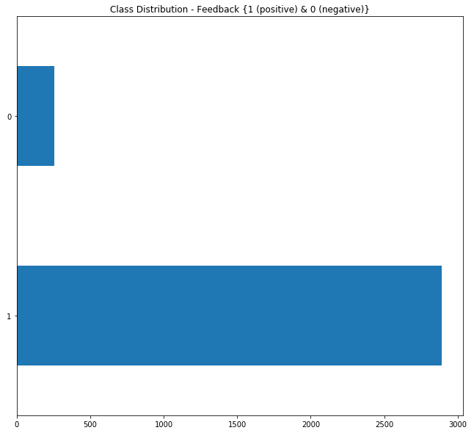
EDA
In both cases, we see distribution among feedback and ratings is highly skewed on the positive side. For the most part, products have been well received by the customers.

Slide 7
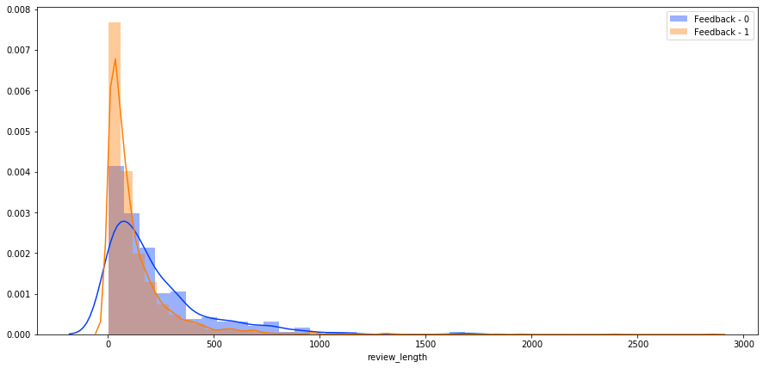
Length of Reviews and Feedback Type
Customers with negative reviews have a tendency to write a longer review

Slide 8
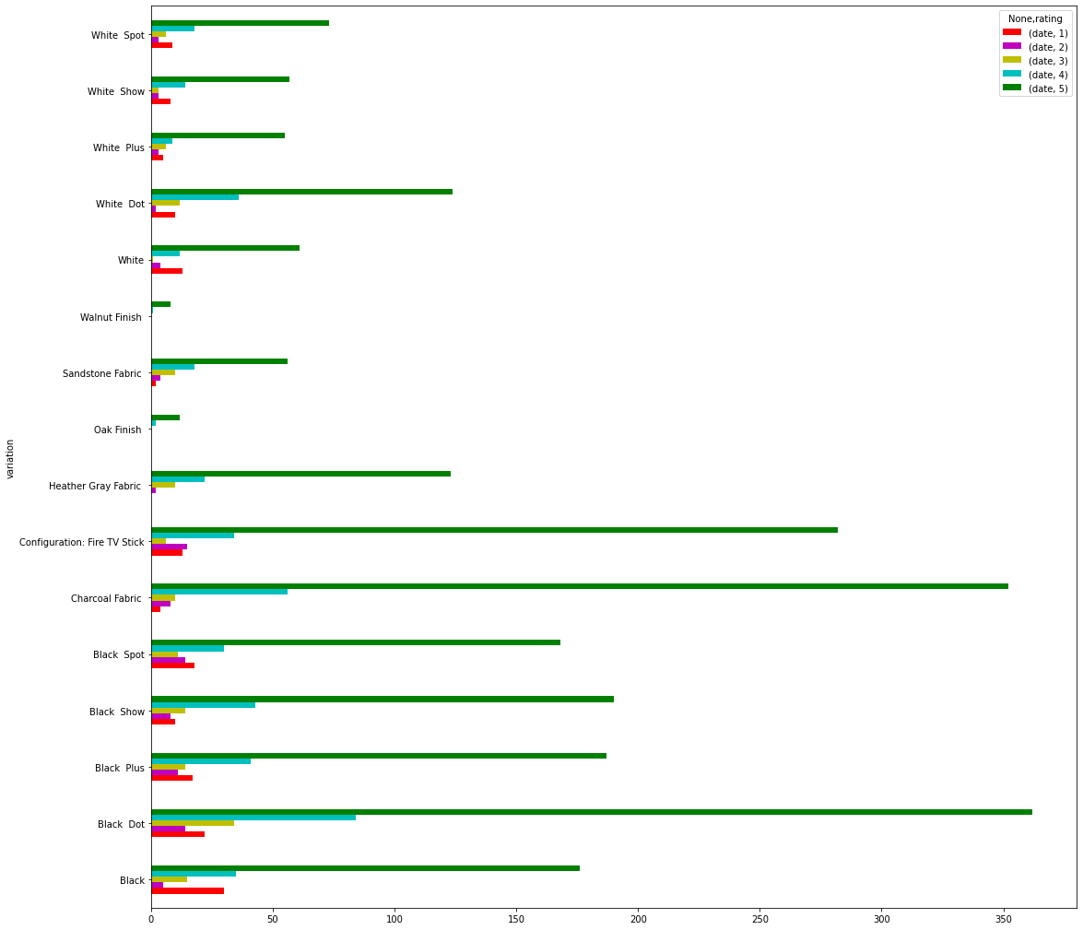
Product Variation and Rating
The Black Dot variant of Amazon Alexa products has the most ratings of 5 among the Amazon Alexa products in the data

Slide 9
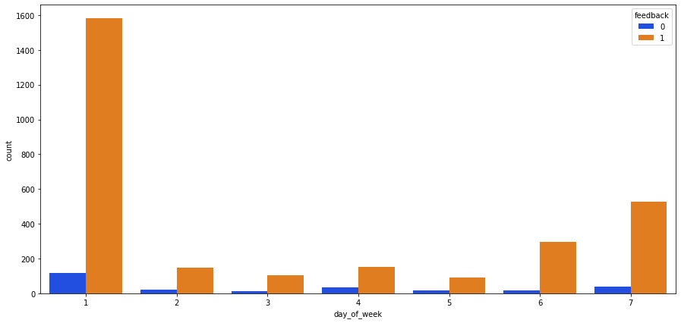
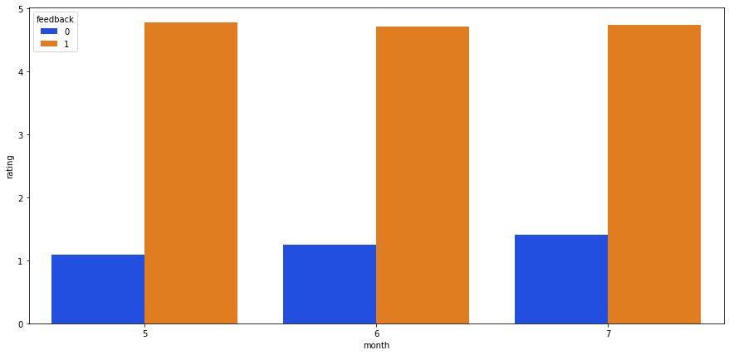
Day of Week, Month and Feedback Type
Customers most likely to write their feedback on Monday and during the month of July

Slide 10
EDA: Key Findings
Ratings need to be greater than 3 to be considered positive
Distribution among feedback and ratings is highly skewed on the positive side
What may help in the future is to stratify the data to avoid a class imbalance
Customers were mostly likely to write reviews on Monday and gave feedback mostly in July

Slide 11
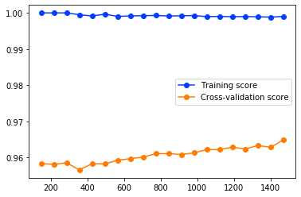
Predictive Modeling
Trained and tested using Random Forest and Gradient Boosting
In each scoring criteria, each model performed well and scored high
Metrics used: Precision, Recall, F1 Score, and Confusion Matrix

Slide 12
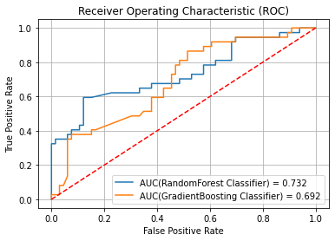
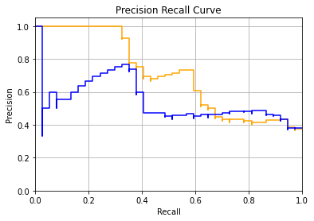
Model Performance: Visualizations
Looks at least a 0.6 threshold for both ROC Curve and Precision Recall Curve looking at bad reviews

Slide 13
Evaluation of Model
The targeted variable was feedback
Table below summarizes performance on negative reviews
MODEL | ACCURACY | PRECISION | RECALL | F1 SCORE
Random Forest | 73% | 71% | 41% | 51%
Gradient Boosting | 69% | 61% | 38% | 47%

Slide 14
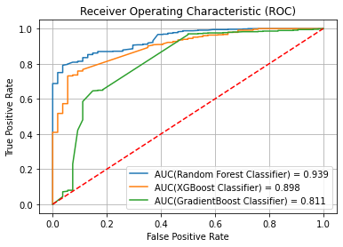
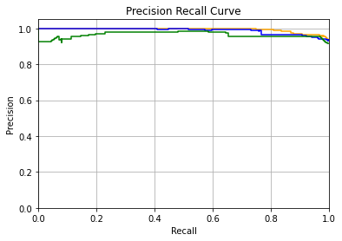
Sentiment Analysis with BERT
Collectively, the three models had high performance as seen in the graphs above.

Slide 15
Sentiment Analysis with BERT Performance
For each rating class:
Model Performance
RATING | ACCURACY
5 | 96.2%
4 | 24%
3 | 0%
2 | 0%
1 | 79.1%
MODEL | ACCURACY | PRECISION | RECALL
Random Forest | 94% | 95% | 99.4%
XGBoost | 94% | 93.2% | 100%
Gradient Boosting | 93% | 95.2% | 97%

Slide 16
Conclusion and Future Work
Takeaway: Predicting what determines negative feedback is more than just looking at the rating.
If we look at the text a customer used in their written review, it helps gives us more insight why they chose certain rating
Based on performance, the model I would pick would be XGBoost since it had highest rate of prediction
Use a bigger dataset when doing multi-class classification

